Slide 1
WinWin
Initial Report Database Sys Presentation
By G14 Waterfall

Slide 2
Contents
Introduction
Organization Background
System Functionalities
An Overview of The System
ER Diagram

Slide 3

Introduction
Motorcycle taxi is the second most used transportation in Bangkok, besides MRT.
Other Ride-hailing applications reduced customer count of motorcycle taxis.
Digitalization of the motorcycle taxi system.
Notes:
ปุญญ์

Slide 4
Organization Background
Matchmaking between customers and motorcycle taxis.
Department of Land Transport, Ministry of Transport is one of our partners.
Winnonie, a startup from Bangchak Corporation, is also one of our partners.
Motorcycle taxis are more familiar with the local route.
Provide chances for motorcycle taxis to make more income.
Reduce waiting time for customers.
Support locals.
Notes:
ton

Slide 5
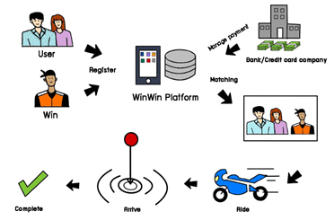
An Overview of The System
Both customers and riders will use the same application
However, their interface will be different based on their user type.
First, Customer and Rider register to the system.
The matchmaking system starts when the user selects
pick-up location and destination
rider preference
payment method
During the service, on motorcycle taxi side, there shall be an update (update status) to let the system know (that the motorcycle taxi has arrived, on the way to the destination, or arrived at the destination.)
After arriving at the destination, customer can review their rider.
Notes:
ปูน

Slide 6
System Functionalities
Register and manage account
Login/Logout system
User Adds Card Info.
Monthly Subscription
Book a ride
User Chooses location
Match a rider to the user
Make payment
Make review
Transaction and Ride History
Rider’s vehicle & station
Rider Top-up Credit
Contact rider’s manager
Notes:
ก้ำ register -> choose location
ทราย make payment -> contact manager

Slide 7
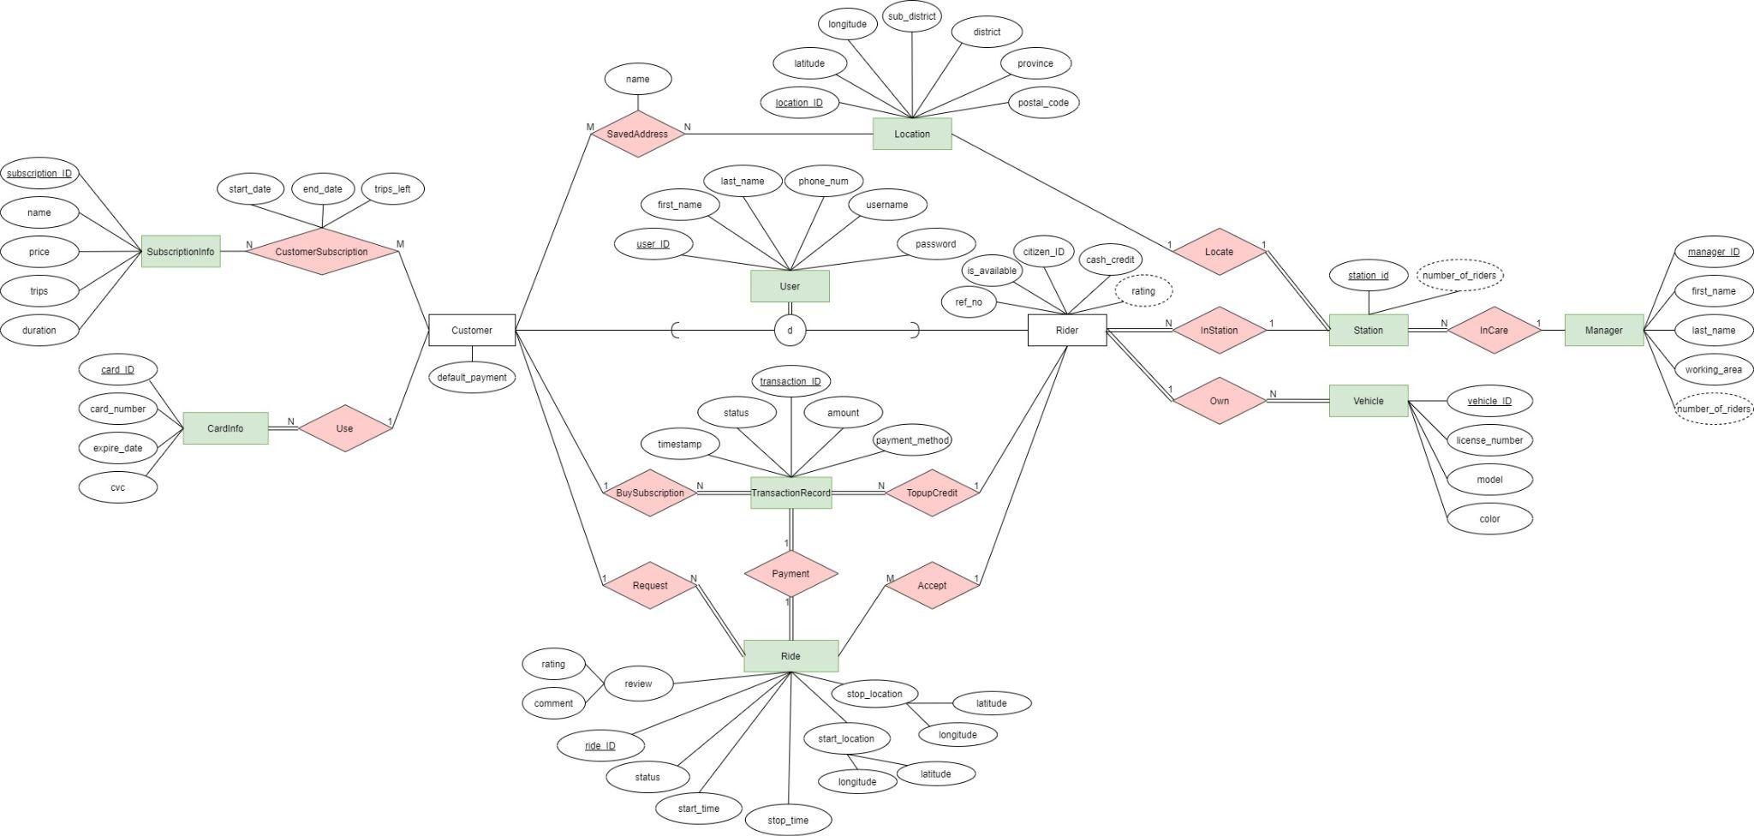
ER Diagram

Slide 8
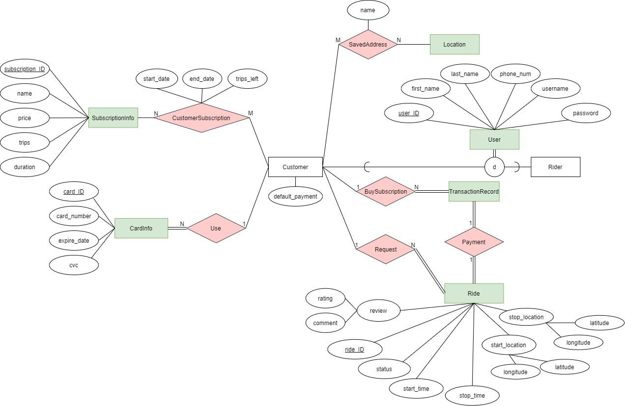
ER Diagram
Notes:
User+Customer+Ride+Card+Subscription
ต้อง

Slide 9
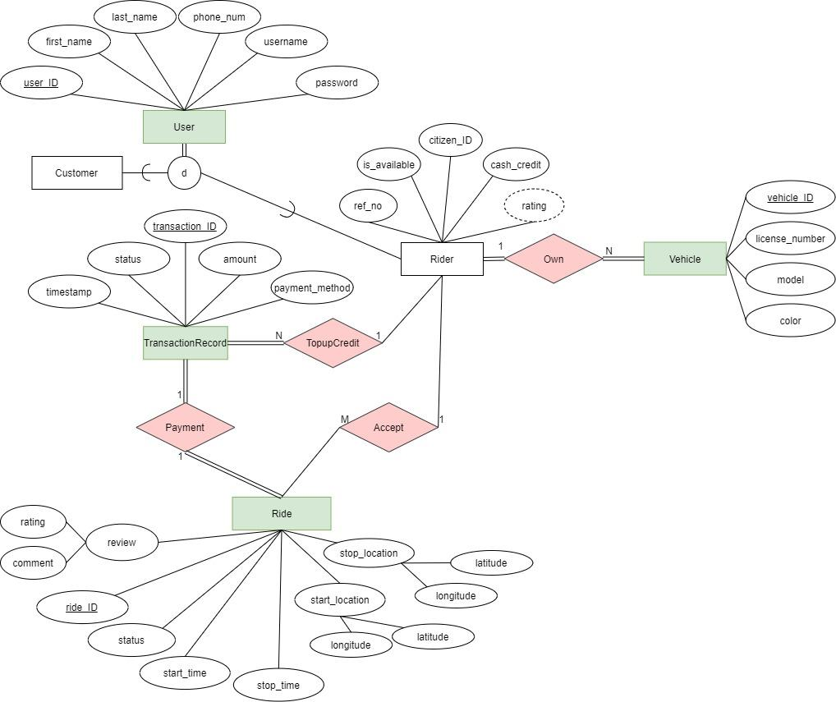
ER Diagram
Notes:
Transaction+Rider+Vehicle+Ride
เกรซ

Slide 10
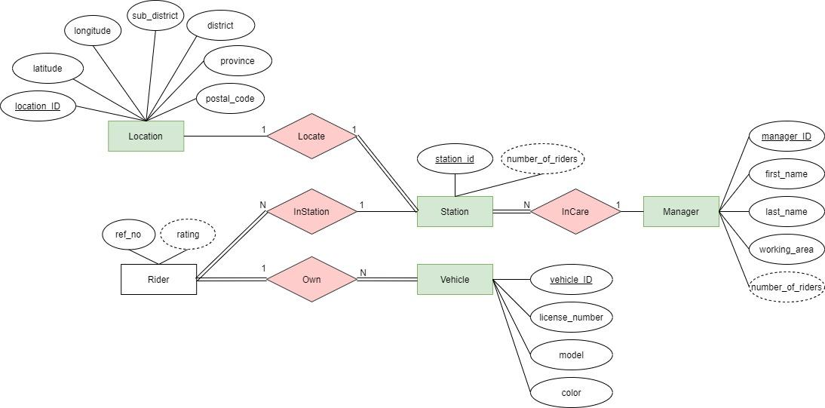
ER Diagram
Notes:
Manager+Station+Location
เย่

Slide 11
Document -Based Design Schema
{ "type": "object",
"bsonType": "object",
"title": "Location",
"description": "Location of customer and station",
"required": [ "_id", "latitude", "longitude", "sub_district", "district", "province", "postalcode" ],
Notes:
ทราย

Slide 12
Document -Based Design Schema
"properties": {
"_id": { "bsonType": "objectid" },
"latitude": { "bsonType": "double", "minimum": -90, "maxmum": 90 },
"longitude": { "bsonType": "double", "minimum": -180, "maxmum": 180 },
"sub_district": { "bsonType": "string", "minLength": 1, "maxLength": 50 },
"district": { "bsonType": "string", "minLength": 1, "maxLength": 50 },
"province": { "bsonType": "string", "minLength": 1, "maxLength": 50 }
},
"patternProperties": {
"postalcode": { "bsonType": "string", "minLength": 1, "maxLength": 5, "pattern": "(1-9)(0-9)*" }
},
"minProperties": 8,
Notes:
ทราย

Slide 13
Document -Based Design Schema
"dependencies": {
"locatedstation": {
"station": { "bsonType": "object" },
"numberofriders": { "bsonType": "int", "minimum": 0, "maxmum": 100 }
},
Notes:
ทราย

Slide 14
Document -Based Design Schema
"customerSavedAddress": {
"bsonType": "array",
"items": {
"locationname": { "bsonType": "string", "minLength": 1, "maxLength": 50 },
"user": { "bsonType": "objectid" },
"userfirstname": { "bsonType": "string", "minLength": 1, "maxLength": 50 },
"userlastname": { "bsonType": "string", "minLength": 1, "maxLength": 50 },
"userphone": { "bsonType": "string", "minLength": 10, "maxLength": 10, "pattern": "(0)(8-9)(0-9)*" }
},
"minItems": 0,
"uniqueItems": true
}}}
Notes:
ทราย

Slide 15
G14 Waterfall - Members
6230123921 Thitaree Setwipattanachai
6230252121 Tarm Kalavantavanich
6231301421 Kanokpich Chaiyawan
6231304321 Kittipong Deevee
6231307221 Jirawat Kusalangkurwat
6231333521 Nopdanai Sayamnet
6231353021 Raviporn Akekunanon
6231372021 Atiwat Deepo

